Slide 1
Unit no 6

Slide 2
Sending SMS Messages Programmatically
Getting Feedback after Sending the Message
Sending SMS Messages Using Intent Receiving
Sending email
Introduction to location based service
Configuring the Android Emulator for Location -Based Services
Geocoding and Map-Based Activities
Multimedia: Audio, Video,
Camera: Playing Audio and Video, Recording Audio and Video, Using the Camera to Take and Process Pictures

Slide 3
Send SMS in Android
It is a messaging service in Android. It lets us send messages to a particular contact number. This is provided to us by Android in two ways –
1. Using the SMSManager API.
2. Using the Built-In application for sending messages
Sending of SMS definitely needs SMS permission, i.e., SEND_SMS permission, which needs to be added to the Manifest file.
<uses-permission android:name="android.permission.SEND_SMS" />
<uses-permission android:name="android.permission.RECEIVE_SMS" />

Slide 4
Methods of SmsMAnager class
ArrayList<String> divideMessage(String text): This approach splits a message text into many fragments, none of which are larger than the maximum SMS message size.
static SmsManager getDefault(): This method is used to acquire the SmsManager's default instance.
void sendDataMessage(String destinationAddress, String scAddress, short destinationPort, byte[] data, PendingIntent sentIntent, PendingIntent deliveryIntent): To send a data-based SMS to a specific application port, use this method.
void sendMultipartTextMessage(String destinationAddress, String scAddress, ArrayList<String> parts, ArrayList<PendingIntent> sentIntents, ArrayList<PendingIntent> deliveryIntents): Send a text-based SMS with many parts.
void sendTextMessage(String destinationAddress, String scAddress, String text, PendingIntent sentIntent, PendingIntent deliveryIntent): This method is used to send a text-based SMS message.

Slide 5
sendTextMessage() method
The sendTextMessage() method accepts five parameters, as follows:
phone - Recipient's phone number
address - Service Center Address (null for default)
message - SMS message to be sent
piSent - Pending intent to be invoked when the message is sent
piDelivered - Pending intent to be invoked when the message is delivered to the recipient

Slide 6
Mainfest file
<?xml version="1.0" encoding="utf-8"?> <manifest xmlns:android="http://schemas.android.com/apk/res/android" xmlns:tools="http://schemas.android.com/tools" package="com.example.sms1"> <uses-permission android:name="android.permission.SEND_SMS" /> <application android:allowBackup="true" android:dataExtractionRules="@xml/data_extraction_rules" android:fullBackupContent="@xml/backup_rules" android:icon="@mipmap/ic_launcher" android:label="@string/app_name" android:roundIcon="@mipmap/ic_launcher_round" android:supportsRtl="true" android:theme="@style/Theme.SMS1" tools:targetApi="31"> <activity android:name=".MainActivity" android:exported="true"> <intent-filter> <action android:name="android.intent.action.MAIN" /> <category android:name="android.intent.category.LAUNCHER" /> </intent-filter> </activity> </application> </manifest>

Slide 7
Activity.xml file
<?xml version="1.0" encoding="utf-8"?> <androidx.constraintlayout.widget.ConstraintLayout xmlns:android="http://schemas.android.com/apk/res/android" xmlns:app="http://schemas.android.com/apk/res-auto" xmlns:tools="http://schemas.android.com/tools" android:layout_width="match_parent" android:layout_height="match_parent" tools:context=".MainActivity"> <TextView android:id="@+id/textView" android:layout_width="match_parent" android:layout_height="wrap_content" android:text="SMS Application !" app:layout_constraintBottom_toBottomOf="parent" app:layout_constraintEnd_toEndOf="parent" app:layout_constraintHorizontal_bias="0.0" app:layout_constraintStart_toStartOf="parent" app:layout_constraintTop_toTopOf="parent" app:layout_constraintVertical_bias="0.061" /> <EditText android:id="@+id/editTextTextNumber" android:layout_width="match_parent" android:layout_height="50dp" android:ems="10" android:hint="Number " android:inputType="number" app:layout_constraintBottom_toBottomOf="parent" app:layout_constraintEnd_toEndOf="parent" app:layout_constraintHorizontal_bias="0.646" app:layout_constraintStart_toStartOf="parent" app:layout_constraintTop_toBottomOf="@+id/textView" app:layout_constraintVertical_bias="0.12" tools:ignore="TouchTargetSizeCheck" />
<EditText android:id="@+id/editTextMessage" android:layout_width="match_parent" android:layout_height="50dp" android:ems="10" android:inputType="textPersonName" android:hint="message" app:layout_constraintBottom_toBottomOf="parent" app:layout_constraintEnd_toEndOf="parent" app:layout_constraintHorizontal_bias="0.711" app:layout_constraintStart_toStartOf="parent" app:layout_constraintTop_toBottomOf="@+id/editTextTextNumber" app:layout_constraintVertical_bias="0.137" tools:ignore="TouchTargetSizeCheck" /> <Button android:id="@+id/button" android:layout_width="match_parent" android:layout_height="wrap_content" android:layout_marginBottom="224dp" android:text="Send " app:layout_constraintBottom_toBottomOf="parent" app:layout_constraintEnd_toEndOf="parent" app:layout_constraintHorizontal_bias="0.0" app:layout_constraintStart_toStartOf="parent" app:layout_constraintTop_toBottomOf="@+id/editTextMessage" /> </androidx.constraintlayout.widget.ConstraintLayout>

Slide 8
Activity.java file
package com.example.sms1; public class MainActivity extends AppCompatActivity { Button send; EditText phone_Number, message; @Override protected void onCreate(Bundle savedInstanceState) { super.onCreate(savedInstanceState); setContentView(R.layout.activity_main); send = (Button) findViewById(R.id.button); phone_Number = (EditText) findViewById(R.id.editTextTextNumber); message = (EditText) findViewById(R.id.editTextMessage); send.setOnClickListener(new View.OnClickListener() { @Override public void onClick(View v) { String phone_Num = phone_Number.getText().toString(); String send_msg = message.getText().toString(); if (ActivityCompat.checkSelfPermission(MainActivity.this, Manifest.permission.SEND_SMS) == PackageManager.PERMISSION_GRANTED) { try { SmsManager sms = SmsManager.getDefault(); // using android SmsManager sms.sendTextMessage(phone_Num, null, send_msg, null, null); // adding number and text sms.sendTextMessage(phone_Num, null, send_msg, null, null); Toast.makeText(MainActivity.this, "Your message send successfully ", Toast.LENGTH_SHORT).show(); } catch (Exception e) { Toast.makeText(MainActivity.this, e.toString(), Toast.LENGTH_SHORT).show(); } } else { if (Build.VERSION.SDK_INT >= Build.VERSION_CODES.M) { requestPermissions(new String[]{Manifest.permission.SEND_SMS}, 10); } } } }); } }

Slide 9
public void onClick(View v) { String phone_Num = phone_Number.getText().toString(); String send_msg = message.getText().toString(); if (ActivityCompat.checkSelfPermission(MainActivity.this, Manifest.permission.SEND_SMS) == PackageManager.PERMISSION_GRANTED) { try { SmsManager sms = SmsManager.getDefault(); // using android SmsManager sms.sendTextMessage(phone_Num, null, send_msg, null, null); // adding number and text sms.sendTextMessage(phone_Num, null, send_msg, null, null); Toast.makeText(MainActivity.this, "Your message send successfully ", Toast.LENGTH_SHORT).show(); } catch (Exception e) { Toast.makeText(MainActivity.this, e.toString(), Toast.LENGTH_SHORT).show(); } } else { if (Build.VERSION.SDK_INT >= Build.VERSION_CODES.M) { requestPermissions(new String[]{Manifest.permission.SEND_SMS}, 10); } }

Slide 10
The use of PendingIntent object
The PendingIntent object piSent is used to notify the sender that the message has been sent.
The PendingIntent object piDelivered is used to notify the sender that the message has been delivered to the recipient when the recipient actually receives the message.
PendingIntent piSent=PendingIntent.getBroadcast(this, 0, new Intent("SMS_SENT"), 0);
PendingIntent piDelivered=PendingIntent.getBroadcast(this, 0, new Intent("SMS_DELIVERED"), 0);
Note: The piDelivered PendingIntent does not fire in the Android emulator. You have to test the application on a real device to view it. However, the piSent PendingIntent works on both, the emulator as well as on a real device.

Slide 11
public void onClick(View arg0) { String no = mobileno.getText().toString(); String msg = message.getText().toString(); //Getting intent and PendingIntent instance Intent intent = new Intent(getApplicationContext(), MainActivity.class); PendingIntent pi = PendingIntent.getActivity(getApplicationContext(), 0, intent, PendingIntent.FLAG_MUTABLE); if (ActivityCompat.checkSelfPermission(MainActivity.this, Manifest.permission.SEND_SMS) == PackageManager.PERMISSION_GRANTED) { //Get the SmsManager instance and call the sendTextMessage method to send message SmsManager sms = SmsManager.getDefault(); sms.sendTextMessage(no, null, msg, pi, null); Toast.makeText(getApplicationContext(), "Message Sent successfully!", Toast.LENGTH_LONG).show(); } else { if (Build.VERSION.SDK_INT >= Build.VERSION_CODES.M) { requestPermissions(new String[]{Manifest.permission.SEND_SMS}, 10); } } }

Slide 13
Use of broadcastReceiver
Two BroadcastReceiver objects, smsSentReceiver and smsDeliveredReceiver, are created in the onResume() method. These are registered using the registerReceiver() method as follows:
registerReceiver(smsSentReceiver, new IntentFilter("SMS_SENT"));
registerReceiver(smsDeliveredReceiver, new IntentFilter("SMS_DELIVERED"));
Inside each BroadcastReceiver object, the onReceive() method is overridden to check the result code using the getResultCode() method and display the appropriate message.
The two BroadcastReceiver objects are unregistered in the onPause() method
unregisterReceiver(smsSentReceiver);
unregisterReceiver(smsDeliveredReceiver);

Slide 14
public void onResume()
{ super.onResume();
smsSentReceiver=new BroadcastReceiver() { @Override public void onReceive(Context arg0, Intent arg1)
{
switch (getResultCode())
{ case Activity.RESULT_OK: Toast.makeText(getBaseContext(), "SMS has been sent", Toast.LENGTH_SHORT).show(); break;
case SmsManager.RESULT_ERROR_GENERIC_FAILURE: Toast.makeText(getBaseContext(), "Generic Failure", Toast.LENGTH_SHORT).show(); break;
case SmsManager.RESULT_ERROR_NO_SERVICE: Toast.makeText(getBaseContext(), "No Service", Toast.LENGTH_SHORT).show(); break;
case SmsManager.RESULT_ERROR_NULL_PDU: Toast.makeText(getBaseContext(), "Null PDU", Toast.LENGTH_SHORT).show(); break;
case SmsManager.RESULT_ERROR_RADIO_OFF: Toast.makeText(getBaseContext(), "Radio Off", Toast.LENGTH_SHORT).show(); break; default: break; } } };

Slide 15
smsDeliveredReceiver=new BroadcastReceiver() {
@Override
public void onReceive(Context arg0, Intent arg1) {
// TODO Auto-generated method stub
switch(getResultCode()) {
case Activity.RESULT_OK:
Toast.makeText(getBaseContext(), "SMS Delivered", Toast.LENGTH_SHORT).show();
break;
case Activity.RESULT_CANCELED:
Toast.makeText(getBaseContext(), "SMS not delivered",Toast.LENGTH_SHORT).show();
break;
}
}
};

Slide 16
Workflow for using permissions
1) Install-time permissions
Install-time permissions give your app limited access to restricted data, and they allow your app to perform restricted actions that minimally affect the system or other apps.
When you declare install-time permissions in your app, the system automatically grants your app the permissions when the user installs your app.
An app store presents an install-time permission
Normal permission
Signature permissions

Slide 17
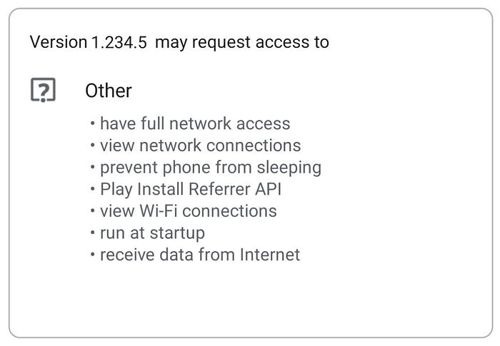

Slide 18
Workflow for using permissions
Runtime permissions
Runtime permissions, also known as dangerous permissions, give your app additional access to restricted data, and they allow your app to perform restricted actions that more substantially affect the system and other apps. Therefore, you need to request runtime permissions in your app before you can access the restricted data or perform restricted actions. When your app requests runtime permission, the system presents a runtime permission prompt, as shown in Figure 2.
Many runtime permissions access private user data, a special type of restricted data that includes potentially sensitive information. Examples of private user data include location and contact information.

Slide 19
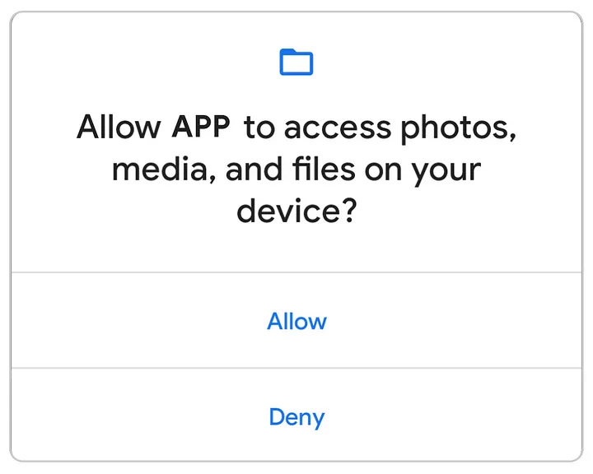

Slide 20
Workflow for using permissions
special permissions
A special permission guards access to system resources that are particularly sensitive or not directly related to user privacy.
These permissions are different than install-time permissions and runtime permissions.
Some examples of special permissions include:
Scheduling exact alarms.
Displaying and drawing over other apps.
Accessing all storage data.

Slide 21
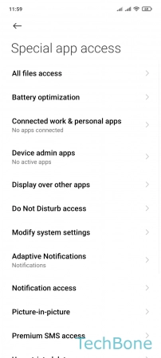

Slide 22
Permission groups
Permissions can belong to permission groups.
Permission groups consist of a set of logically related permissions.
Permissions are divided into nine groups, allowing users to grant all permissions encompassed by a single action by bundling them together as a group.
For example, to provide a user with permission to view, edit, and add Contacts, it’s more efficient to group these permissions into a single permission group (called Contacts) than to request each individually.

Slide 23
Permission Group | Description
Calendar | Managing calendars
Camera | Taking photos and recording videos
Contacts | Managing contacts
Location | Current device location
Microphone | Audio recording
Phone | Dialing and managing phone calls
Body Sensors | Heart rate and similar data
SMS | Sending and viewing messages
Storage | Accessing photos, media, and files

Slide 25
